Slide 1

Challenges in metabolomics research
Knowledge that will change your world
2nd UAB Metabolomics Workshop
June 2-5, 2014
Stephen Barnes, PhD
Director, Targeted Metabolomics and Proteomics Laboratory

Slide 2
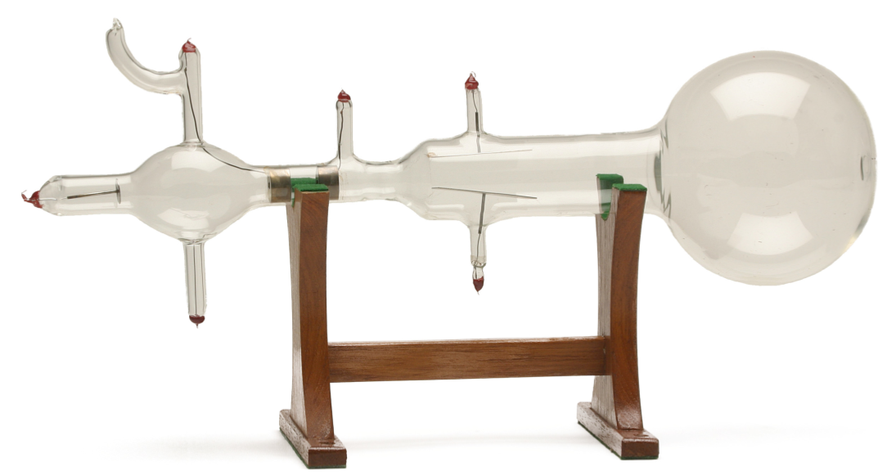
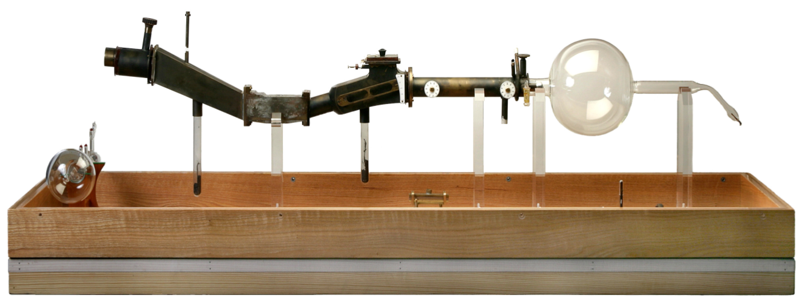
Nuclear physics moves to biology
1897 JJ Thomson discovers the electron (cathode rays)
1919 Aston using a mass spectrograph shows that Neon with a non-integer MW (20.2 Da) is composed of two isotopes, ²⁰Ne and ²²Ne
http://www.asms.org/Publications/Historical/HistoryofMassSpectrometry/tabid/94/Default.aspx

Slide 3
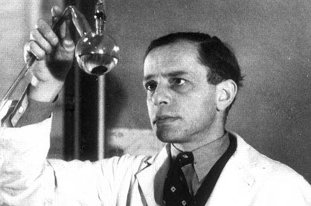
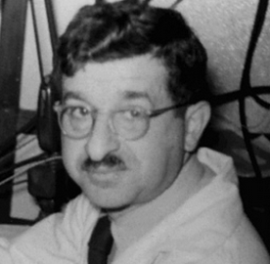
Transition to biology
While the politicians, tyrants, dictators and despots were salivating at the thought of developing nuclear weapons from unstable isotopes in the early part of the 20th Century, two scientists began the pursuit of the peaceful use of stable isotopes, initially deuterium (²H), and later carbon (¹³C) and nitrogen (¹⁵N), to study biochemical pathways
Understanding the pathways of metabolism was born
Ralf Schoenheimer
David Rittenberg

Slide 4
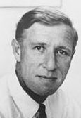
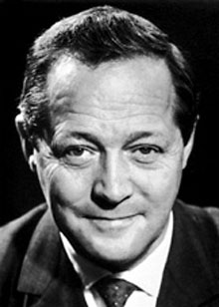
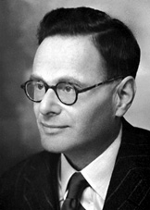
Direction of NIH Research 1950-2012
Metabolomics
1950s-60s emphasis on determining metabolic pathways – 20+ Nobel prizes
1950s-early 1980s Identification and purification of proteins
1995-present Omics galore
Transcriptomics (microarray, deep sequencing, RNA seq)
Proteomics
1980-1988 Sequencing of genes – cDNA libraries –orthogonal research
Bloch Lynen Krebs
2012 Human genome ENCODE project reveals the extent of DNA expression and roles for “junk” DNA, as well as intergenic proteins
1988-2000 Sequencing of the human genome – period of non-orthogonal research – where did all the genes go? junk DNA?
2006 First ENCODE project on 1% of the human genome reveals RNAs coming from more than one gene
2004 Tiling arrays reveal that most of the genome is expressed

Slide 5
Metabolism to metabolomics
Measured with enzymes – NAD(P)H absorbance/fluorescence
Studies of glycolytic and the TCA cycle intermediates one at a time
Organic acids, fatty acids and amino acids by GC
Volatile derivatives, Flame Ionization Detection
GC-MS started in mid-70s
Capillary GC gave far higher chromatographic resolution than the packed ¼” ID columns (1975/6)

Slide 6
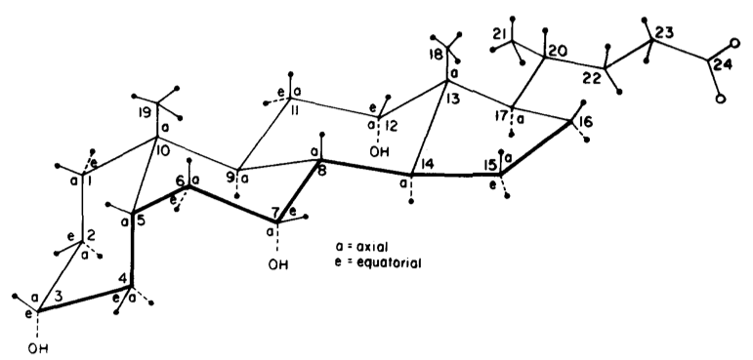
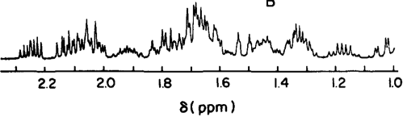
How NMR became a player
Mid 60s – introduction of Fourier transform analysis
Late 70s – introduction of superconducting magnets
Early 80s - pulse sequences
Cholic acid
Barnes & Geckle, 1982

Slide 7
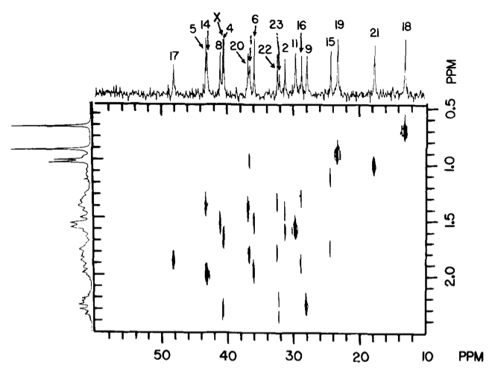
Pulse sequences in NMR (HetCor)
Waterhous et al. (1985)

Slide 8
Progress in LC-MS
Commercial HPLC appeared in the early 1970s to separate thermally stable and unstable molecules
The challenge remained to find a way to get the unstable compounds into the gas phase
Applied to macromolecules (peptides, proteins) as well as metabolites
Thermospray had some initial success
Electrospray ionization and chemical ionization radically changed analysis, allowing compounds to go into the gas phase at atmospheric pressure and room temperature

Slide 9
LC-MS
Suddenly, there were what appeared to be no limits (or very few) to what could be analyzed
Unheard of, robust mass spectrometers came into play
“A reliable mass spectrometer” was considered in 1990 to be an oxymoron

Slide 10
Types of LC-MS analysis
Single quadrupole LC-MS analysis
Triple quadrupole LC-MS analysis
LC-time-of-flight
(TOF)-MS
Multiple reaction monitoring (MRM)
FT-ICR MS
Q-TOF
Orbi-trap
TripleTOF
Ion Mobility

Slide 11
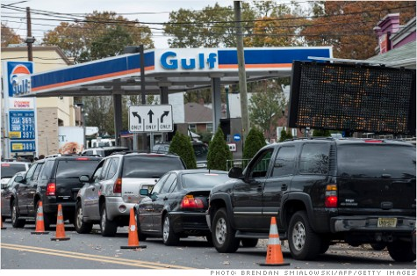
World without gas!

Slide 12
Metabolomics workflow
What is the question and/or hypothesis?
Samples – can I collect enough and of the right type?
Storage, stability and extraction
Validation of the metabolite ID
MSMS
Database search to ID significant metabolite ions
Choice of the analytical method
NMR
GC-MS
LC-MS
Pathway analysis and design of the next experiment
Statistical analysis
Adjusted p-values
Q-values
PCA plots
Data collection
Pre-processing of the data

Slide 13
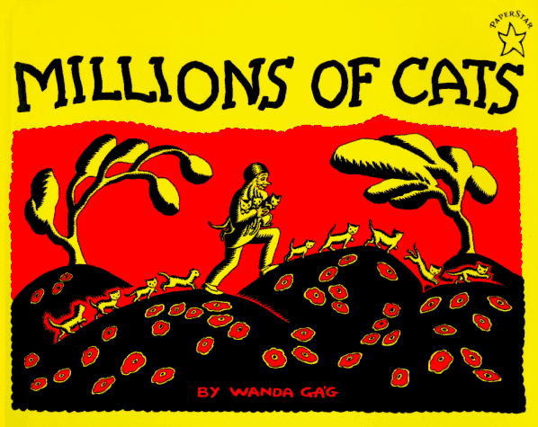
Data explosion

Slide 14
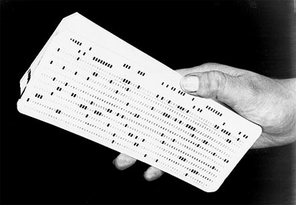
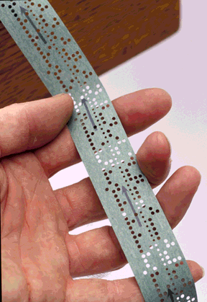
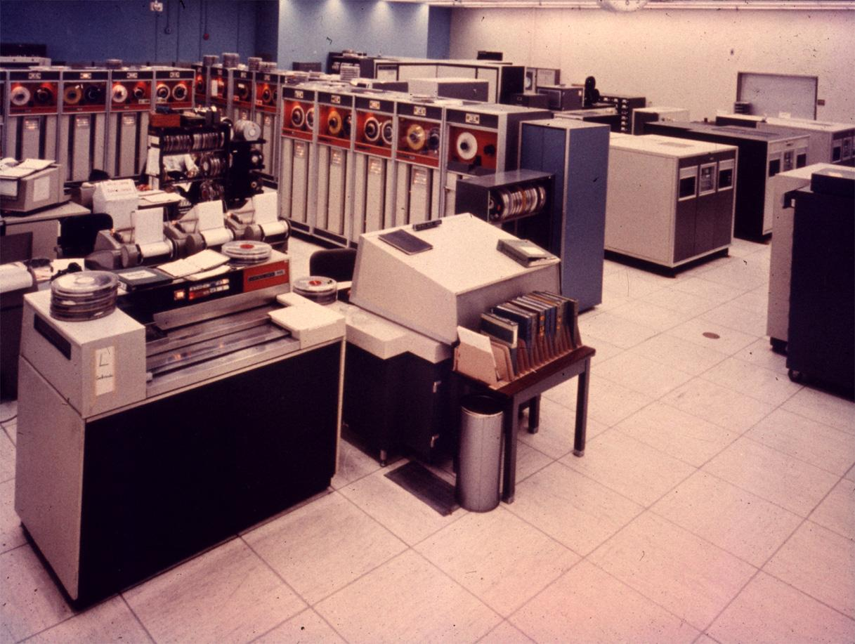
Changing times in Computing
1950 The Cambridge colleagues of Watson and Crick calculated the structure of DNA by putting data onto punched cards and taking them by train to London for analysis – and to the fog – the “cloud” in 1950s
1964 Seymour Cray develops the CDC 6600 (1 Mflops)
1967 I used paper tape to collect data from a radio gas chromatograph and then submitted them via a terminal reader to the CDC 6600 at the University of London

Slide 15
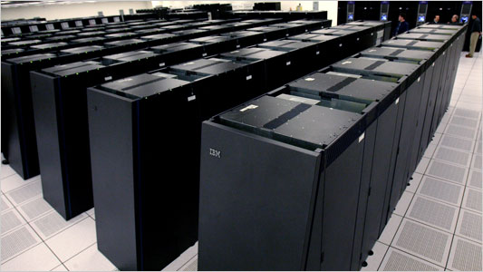

Today in Computing
On my desk in 2013
IBM Blue-Gene
The Apple MacBook Air with 2 quad core Intel i7 processors
Operates at 2.0 GHz
Memory of 8 GB
Access 1.333 GHz
512 GB Flash memory storage
10 Gbs Thunderbolt I/O
Also costs ~$2,000
Parallel processing with 2,048 700 MHz computers operating at 4.733 Tflops
Replaced by Cheaha, in its current configuration it has 48 compute nodes with two 2.66GHz 6-core Intel CPUs per node (576 cores total)
It operates at 6.125 Tflops

Slide 16
Great challenges in metabolomics
The extent of the metabolome
From gaseous hydrogen to earwax
Having complete databases
METLIN has 60,000+ metabolite records, but your problem always creates a need to have more
Current lack of a MSMS database
Storing and processing TBs of data
Standards and standard operating procedures
Being able to do the analyses in real time

Slide 17
NIH Common Fund Metabolomics Program
Metabolomics Workbench: http://www.metabolomicsworkbench.org/
Regional Comprehensive Metabolomics Research Centers
University of Michigan: http://mrc2.umich.edu/index.php
UC Davis Metabolomics Center: http://metabolomics.ucdavis.edu/
RTI International: http://www.rti.org/page.cfm?objectid=3BC41B11-068E-1405-9A6F79D91D8D69EC
SE Center for Integrated Metabolomics: http://secim.ufl.edu/
Resource Center for Stable Isotope Metabolomics: http://bioinformatics.cesb.uky.edu/bin/view/RCSIRM/
Mayo Clinic Metabolomics Resource: http://www.mayo.edu/research/core-resources/metabolomics-resource-core/overview

